Slide 1
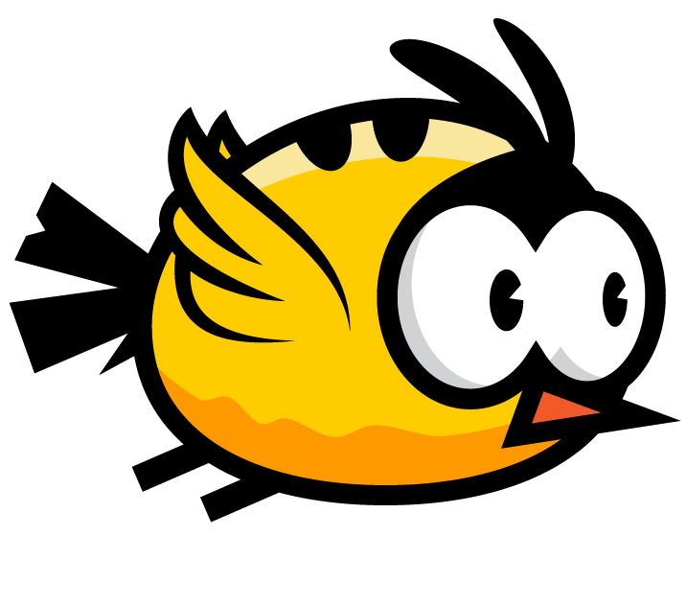
The Flappy Bird
Prajjwal Sharma
20313202715
CSE – 2
Industrial Training Project

Slide 2
Introduction
I tried to bring the popular game Flappy Bird, which is originally on Android platform . The game is a side-scroller where the player controls a bird, attempting to fly between rows of green pipes without coming into contact with them. If the player touches the pipes, it ends the game. The bird briefly flaps upward each time the player taps the screen; if the screen is not tapped, the bird falls due to gravity.
Flappy bird is a simple and easy browser based game which is developed using basic html , css , javascript and jQuery . It consists of a window inside which a bird attempts to fly between green pipes without hitting them ,by doing so the score is made. Subsequently , the speed of the pipes is increased .

Slide 3
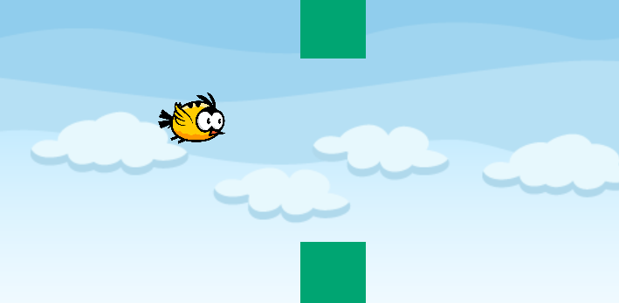
Objective
The objective was to direct a flying bird, named "Faby", who moves continuously to the right, between sets of Mario-like pipes. If the bird touches the pipes, the player loses. Faby briefly flaps upward each time the player presses the space bar ; if the space bar is not pressed, Faby falls because of gravity; each pair of pipes that he navigates between earns the player a single point.

Slide 4
How the web app works ?
A user goes to their browser, types in a website, and hits Enter. The browser goes out and finds the internet-facing computer that the website lives on and asks the server for the specific page. The server responds to the request by sending some files over to the browser. The browser executes those files and shows something (hopefully!) to the user.
The user can now visually interact with the website. The code that has been parsed by the browser may or may not have instructions telling the browser to react to user input in various ways: from changing what the page looks like, to reporting back to the server on what it is the user did, to getting even more code to parse and display.

Slide 5
Server side vs Client side
The main thing to take away from the last paragraph is that in a web application, there are basically two programs running at the same time:
The code that lives on the server and responds to HTTP requests.
The code that lives in the browser and responds to user input.
If you’re coming from a world where software development and cat herding are two wildly different things, you’re probably used to writing code in n < 3 && n > 0 languages, packaging it up, and then shipping it off. That is… not the case here.

Slide 6
Server side code
Languages/frameworks include but are not limited to Ruby (Rails), Javascript (Node.js), Python (Django), PHP, C#, and Java; but the list of possibilities is infinite. Any code that can run on a computer and respond to HTTP requests can run a server.
Stores persistent data (user profiles, instatweets, mybook pages, etc.).
Cannot be seen by the user (unless something is terribly wrong).
Can only respond to HTTP requests for a particular URL, not any kind of user input.
Creates the page that the user finally sees (this is generally only true in web applications that choose to render most of their layouts on the server).

Slide 7
Client side code
Languages used include: HTML, CSS, and Javascript. Nothing else. But don’t worry, there’s a million frameworks and transpiles-to-[CSS|HTML|JS] languages to choose from (and keep yourself updated on) anyway.
Parsed by the user’s browser.
Reacts to user input.
Can be seen and edited by the user in full.
Cannot store anything that lasts beyond a page refresh.
Cannot read files off of a server directly, must communicate via HTTP requests.
Creates the page that the user finally sees (this is generally only true in single page applications).

Slide 8
Technologies used in the project

Slide 9
HTML and CSS
HTML stands for Hyper Text Markup Language, which is the most widely used language on Web to develop web pages.
HTML is a markup language and makes use of various tags to format the content. These tags are enclosed within angle braces <Tag Name>. Except few tags, most of the tags have their corresponding closing tags. For example, <html> has its closing tag </html> and <body> tag has its closing tag </body> tag etc.
Everything that is seen on the web page is made using html , it is the basic element of every web page . The various sections of webpage are divided using <div> tag in html .

Slide 10
CSS is used to control the style of a web document in a simple and easy way. CSS is the acronym for "Cascading Style Sheet".
CSS handles the look and feel part of a web page. Using CSS, you can control the color of the text, the style of fonts, the spacing between paragraphs, how columns are sized and laid out, what background images or colors are used, layout designs,variations in display for different devices and screen sizes as well as a variety of other effects.
CSS is easy to learn and understand but it provides powerful control over the presentation of an HTML document. Most commonly, CSS is combined with the markup languages HTML or XHTML.

Slide 11
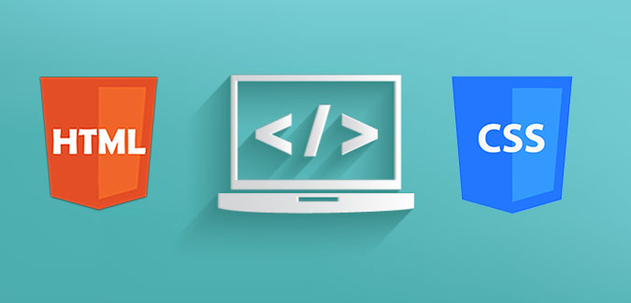

Slide 12
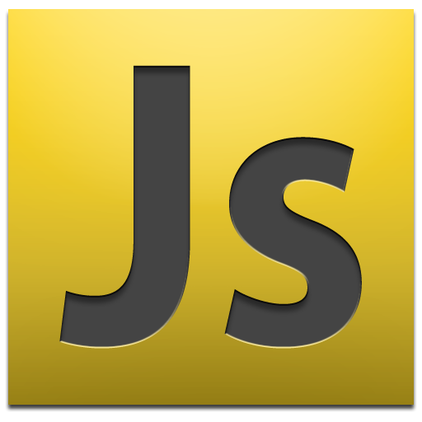
JavaScript
JavaScript is a dynamic computer programming language. It is lightweight and most commonly used as a part of web pages, whose implementations allow client-side script to interact with the user and make dynamic pages. It is an interpreted programming language with object-oriented capabilities.
All the transitions of the bird,poles are done using javaScript , it consists of functions which are used for various tasks in the project.

Slide 13

jQuery
jQuery is a fast, small, and feature-rich JavaScript library. It makes things like HTML document traversal and manipulation, event handling, animation, and Ajax much simpler with an easy-to-use API that works across a multitude of browsers. With a combination of versatility and extensibility, jQuery has changed the way that millions of people write JavaScript.
jQuery simplifies HTML document traversing, event handling, animating, and Ajax interactions for rapid web development.
jQuery is a JavaScript toolkit designed to simplify various tasks by writing less code.

Slide 14
What’s next ?

Slide 15
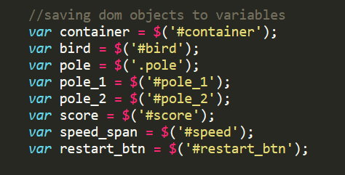
Saving DOM objects to variable

Slide 16

setInterval() function
The setInterval() method calls a function or evaluates an expression at specified intervals (in milliseconds).
The setInterval() method will continue calling the function until clearInterval() is called, or the window is closed.

Slide 17
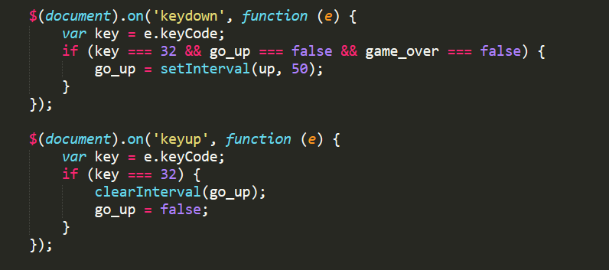
.on() Method
Attach an event handler function for one or more events to the selected elements.
The .on() method attaches event handlers to the currently selected set of elements in the jQuery object.

Slide 18
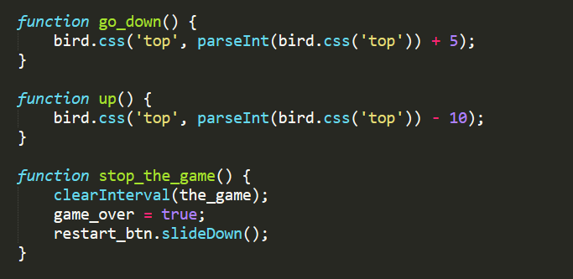

Functions created

Slide 19
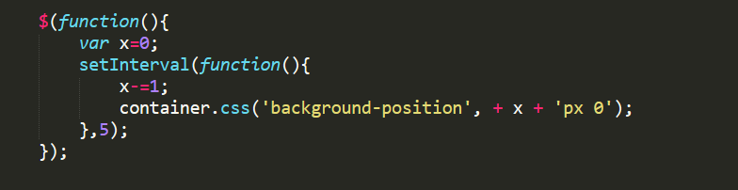
The function responsible for moving the background in the container window.

Slide 20
THANK
YOU
VERY MUCH

